Slide 1
LAB. SISTEMAS OPERATIVOS
Laboratorio de SO
E – M 2019

Slide 2
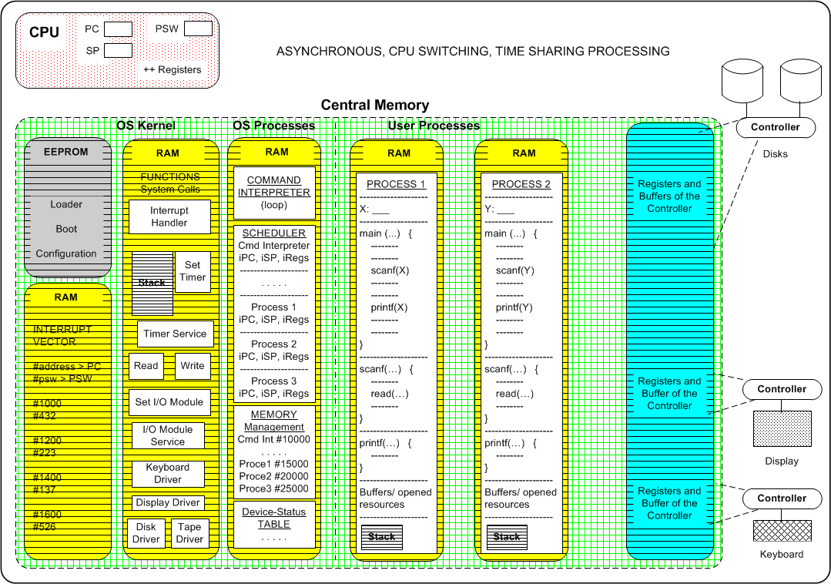

Slide 3
CPU needs for exec
To fill in the next CPU registers before transfering execution
PC (program counter) _ with _ the memory address of the next instruction
PSW (processor status Word) _ with _ flags initial values, in particular the one with the supervisor mode of execution
SP (stack pointer) _ with _ the initial address of the stack área of a program or process

Slide 4
Operating System Kernel
Subroutines / functions
Loader, Boot, Configure, Run, Dir, Read, Write, …
Interrupt Vector
Contains the starting memory address and process status word of every subroutine / function

Slide 5
Operating System Processes
Command Interpreter
Receives and validates the user or program commands, and execute them up
Process Administrator
Builds, starts, manages and terminates processes
Scheduler (part of the process administrator)
Selects the next process to have CPU time

Slide 6
Operating System Processes
Memory Administrator
Allocates and manage memory for every process
File Administrator
Creates, opens, copies, close or delete files and directories

Slide 7
I/O completed
Example: Reading from Keyboard or Disk, inside a process
How the CPU learns that an I/O has been completed? Two ways
CPU checks __________
CPU receives ___________

Slide 8
Referencias
Presentación de Ramon Ríos.
18-enero-2019

